Slide 1
INTERNSHIP 2024 SOLID PROPULSION
WEEK 6 PROGRESS REPORT

Slide 2
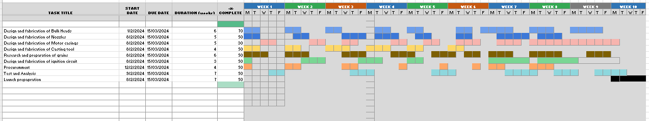
SOLID PROPULSION N3.5 GANTT CHART
https://docs.google.com/spreadsheets/d/1VY4SawCWrPL2GLTEFuGG4h4JeNr9AABdcgp3iwnV6gs/edit?usp=drivesdk

Slide 3
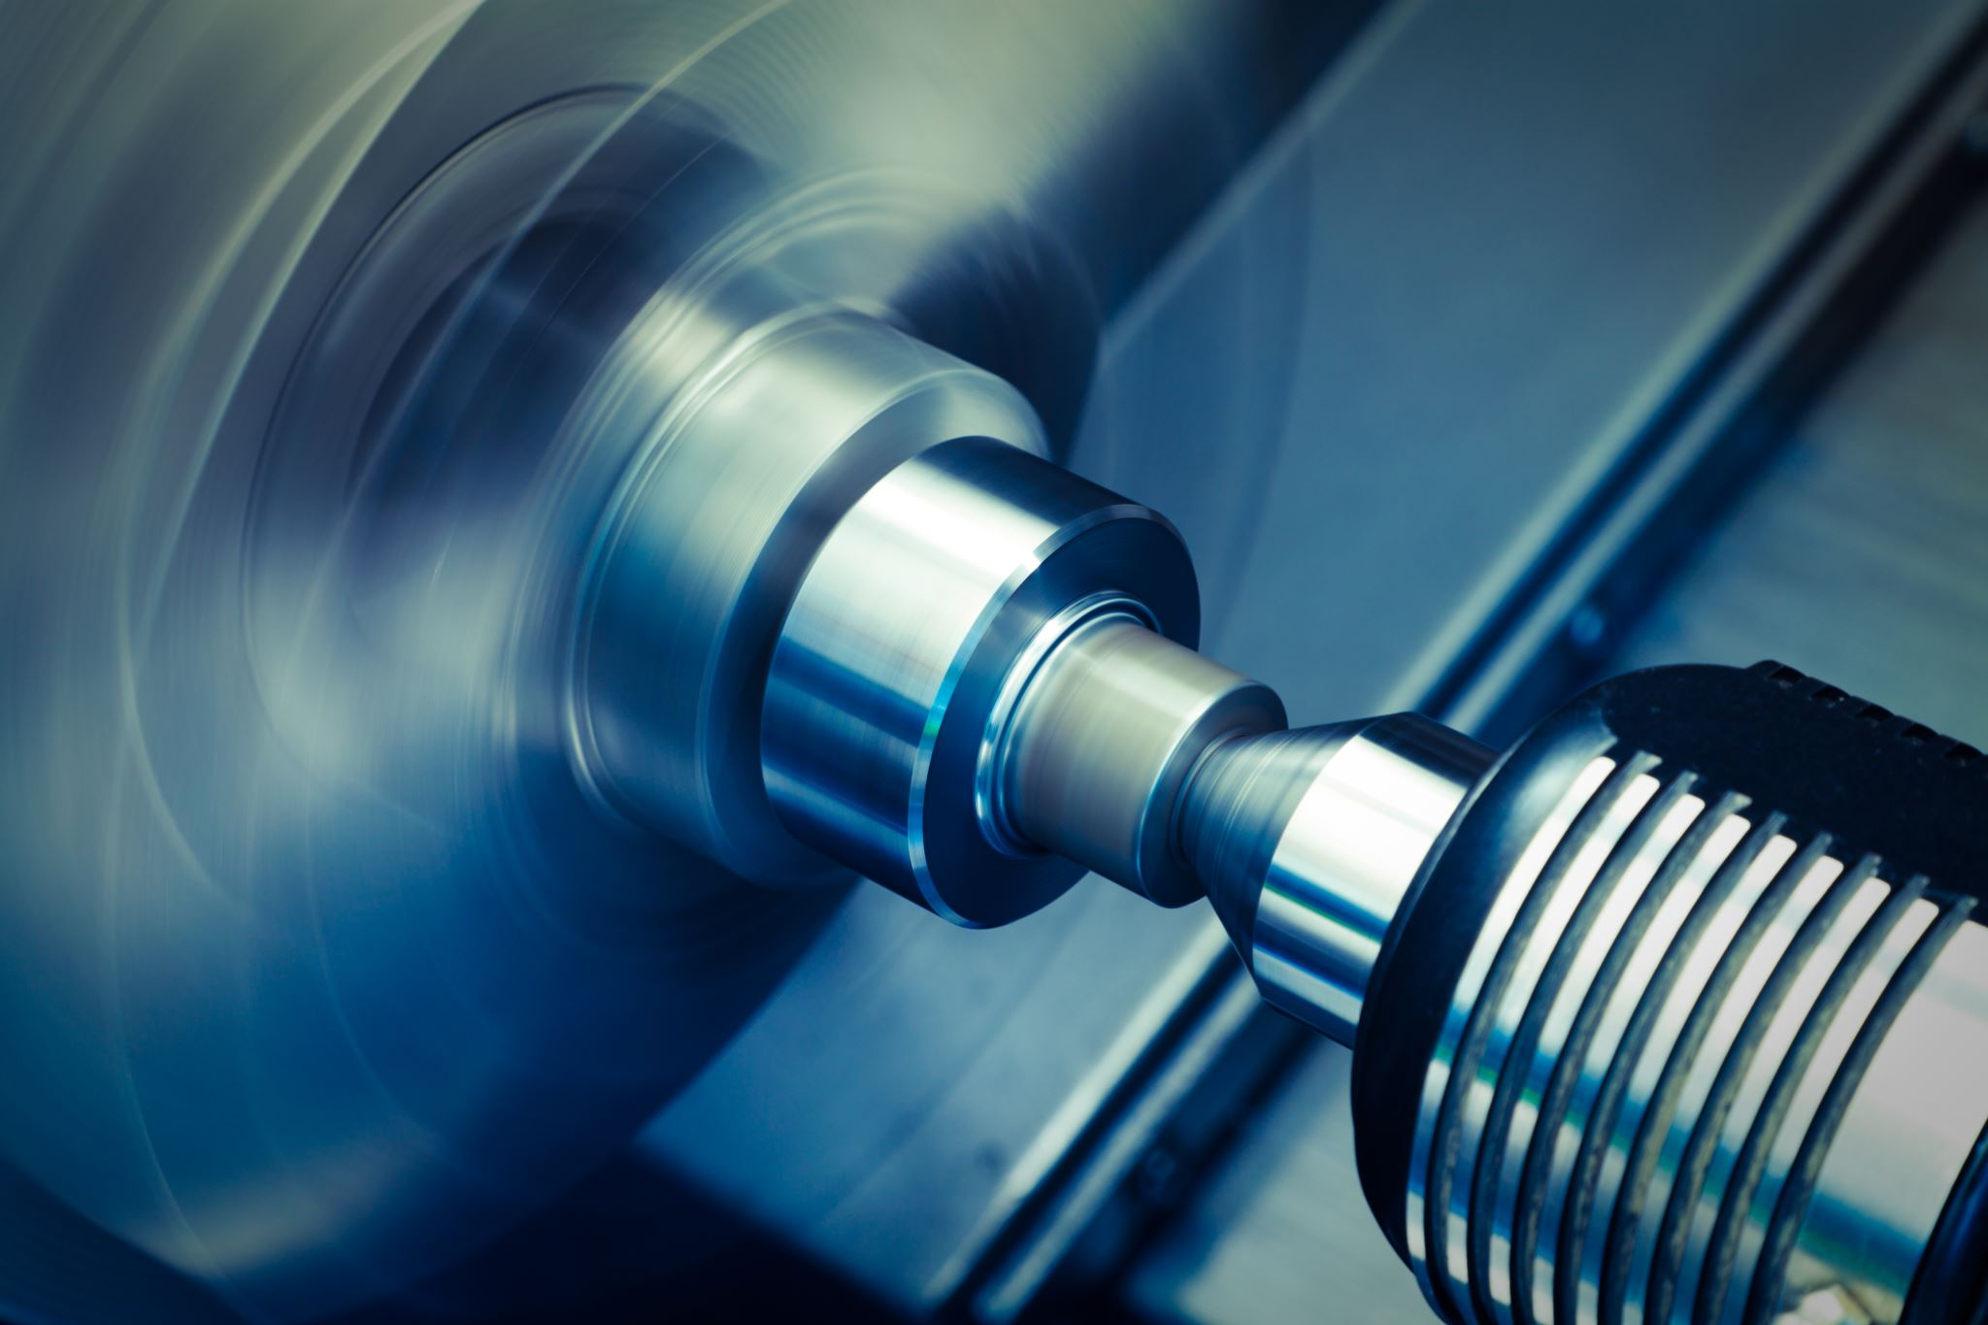
SIXTH WEEK’S OBJECTIVES
Analysis of the static test
Machining of nozzles
Machining of bulk heads
Purchase of Materials
Cooking grains
Design of casting tool

Slide 4
TASKS COMPLETED
Motor disassembly and assessment.
Static test analysis.
Redesigned casting moulds.
Cooked 3 grains
Procured some materials.
Fabricated 4 nozzles.
Reviewed compression moulding machine upgrade.

Slide 5
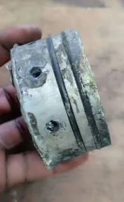
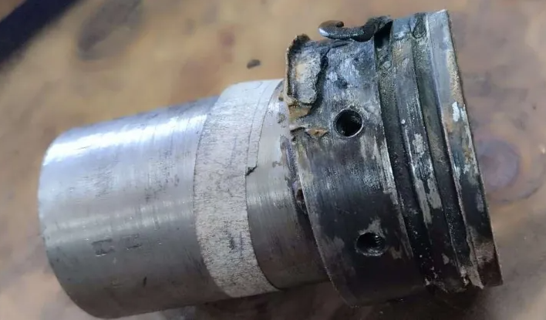
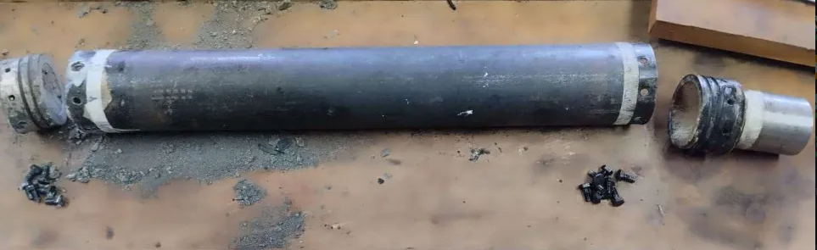
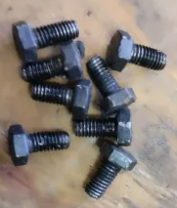
MOTOR ASSESSMENT
Nozzle O-rings destroyed
Bulkhead O-rings intact
All metallic components intact

Slide 6
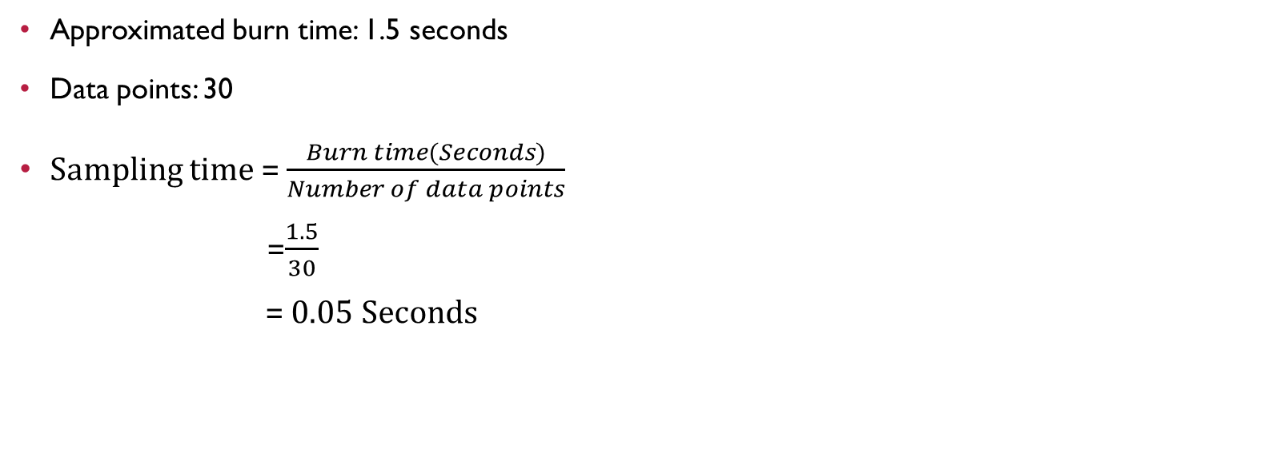
STATIC TEST ANALYSIS
Approximated burn time: 1.5 seconds
Data points: 30
Sampling time = $\frac{Burn time(Seconds)}{Number of data points}$
=$\frac{1.5}{30}$
= 0.05 Seconds
FUTURE IMPROVEMENTS
Update code on the time stamp
Integrate pressure sensor

Slide 7
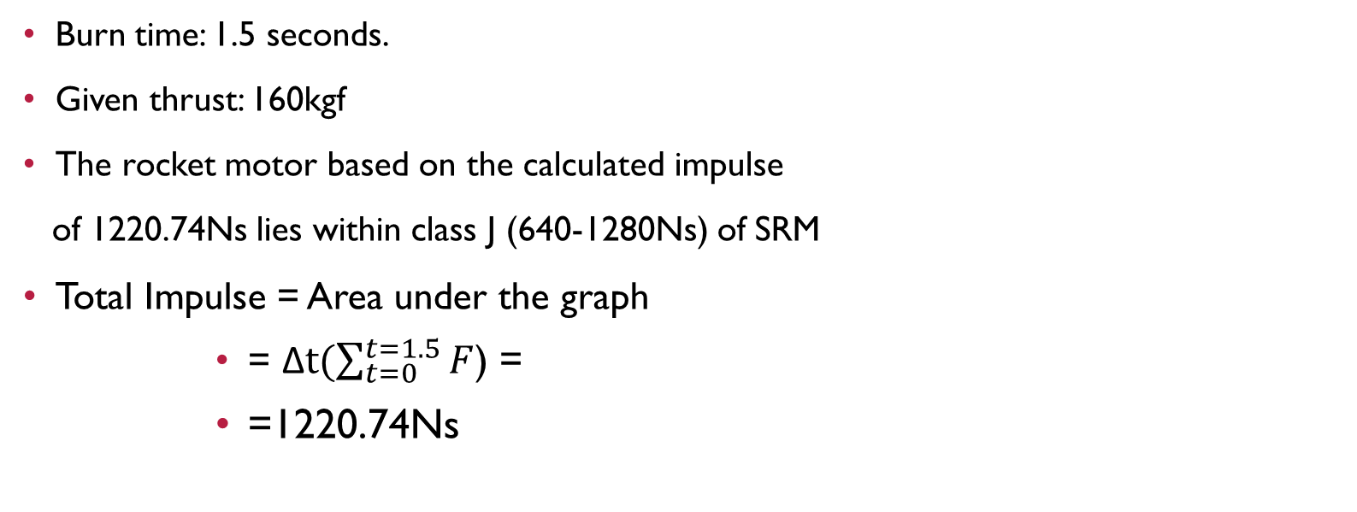
STATIC TEST ANALYSIS
Burn time: 1.5 seconds.
Given thrust: 160kgf
The rocket motor based on the calculated impulse
of 1220.74Ns lies within class J (640-1280Ns) of SRM
Total Impulse = Area under the graph
= Δ$t(\sum_{t=0}^{t=1.5}{F}$) =
=1220.74Ns

Slide 8
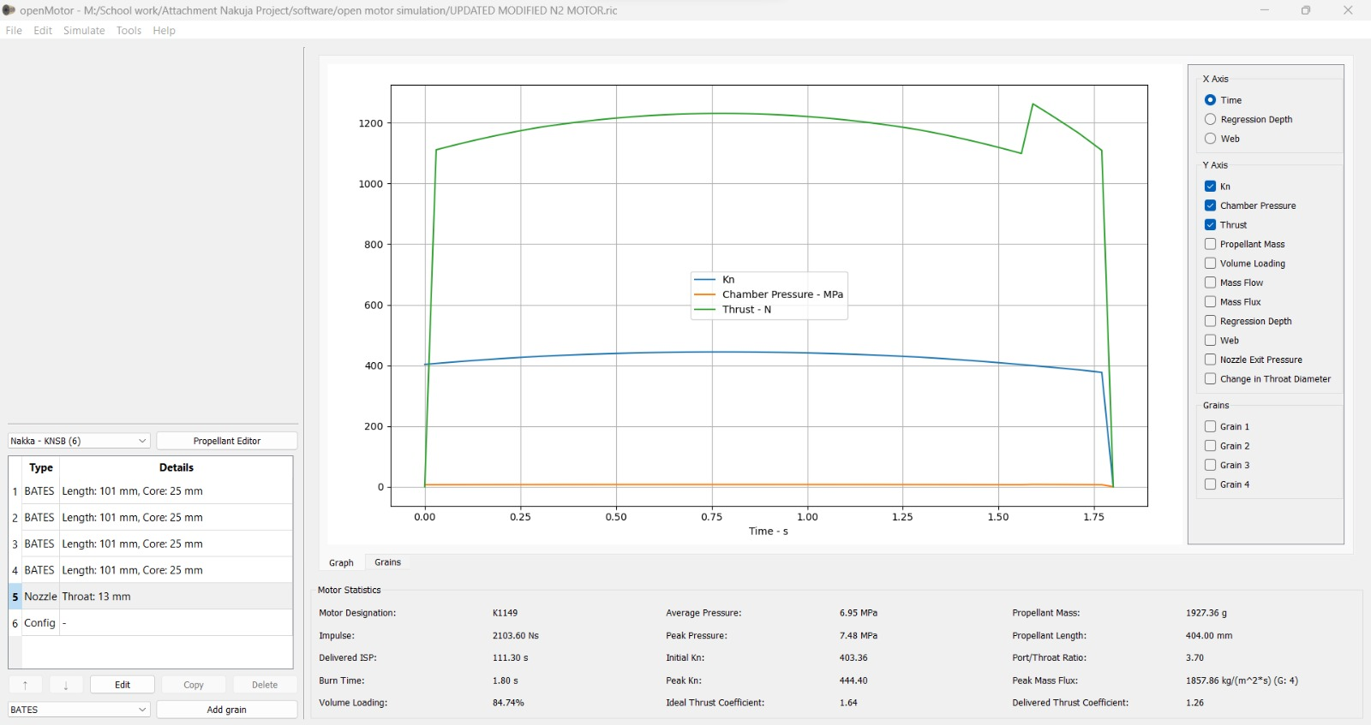
SIMULATED THRUST CURVE
IMPULSE = 2103.6Ns

Slide 9
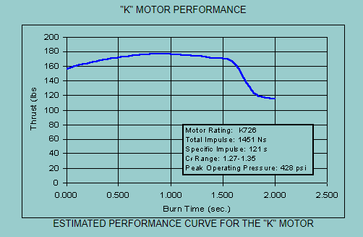
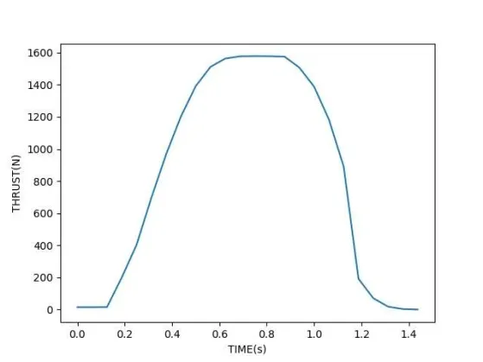
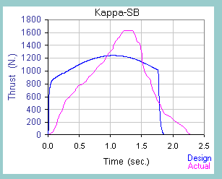
STAtic test analysis
OUR THRUST CURVE

Slide 10
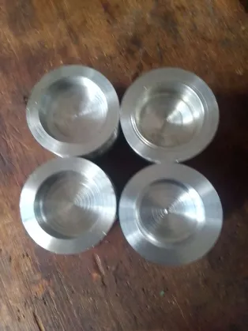
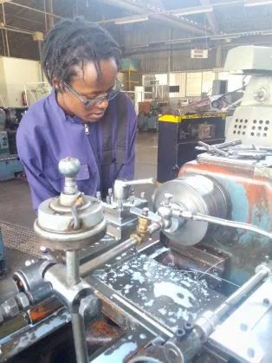
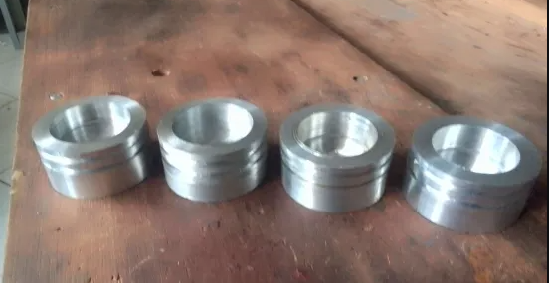
MACHINING BULK HEADS

Slide 11
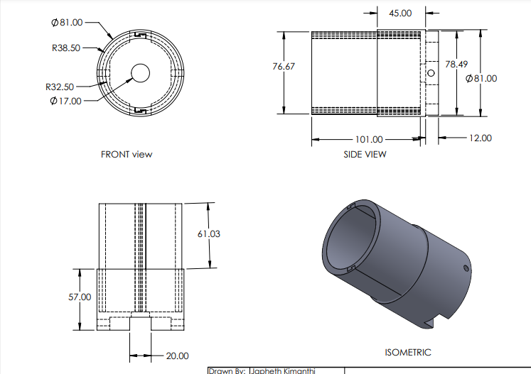
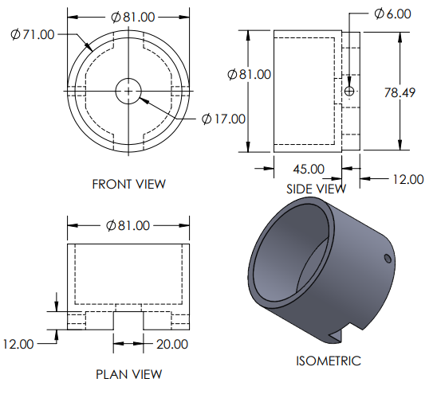
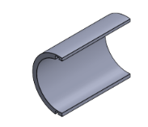
REDESIGNING CASTING MOULDS

Slide 12
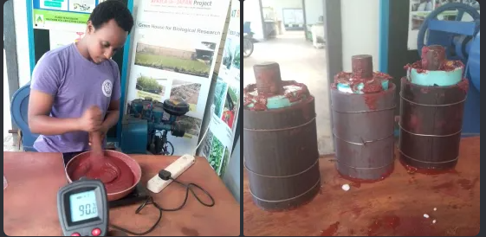
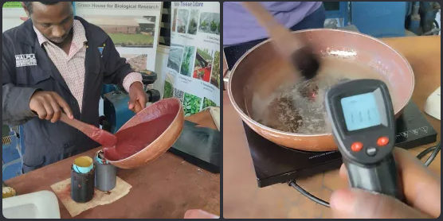
COOKING OF GRAINS

Slide 13
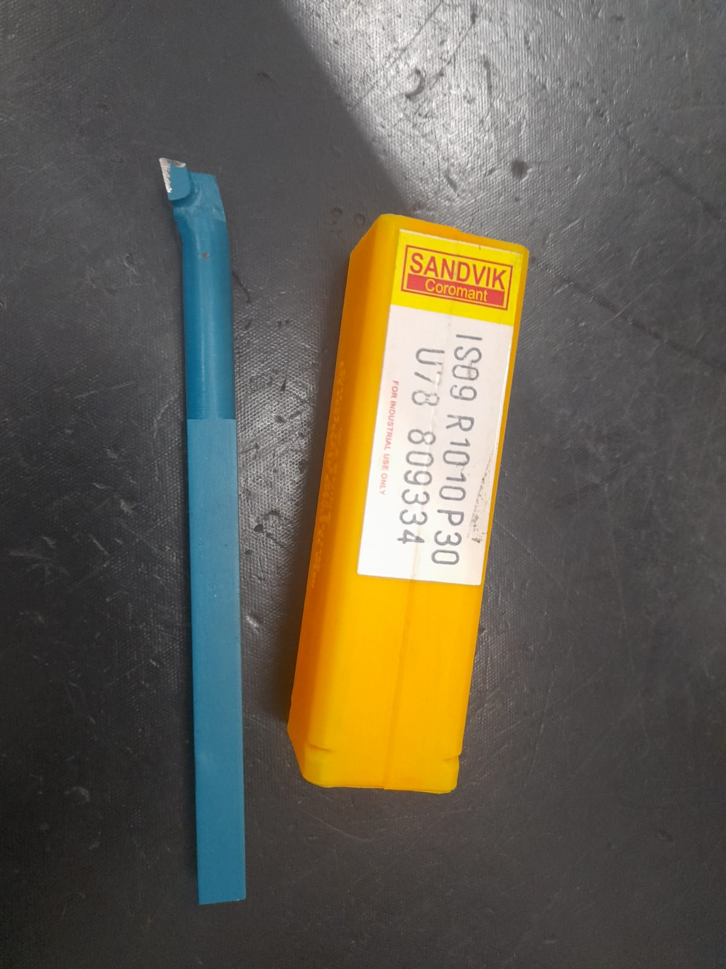
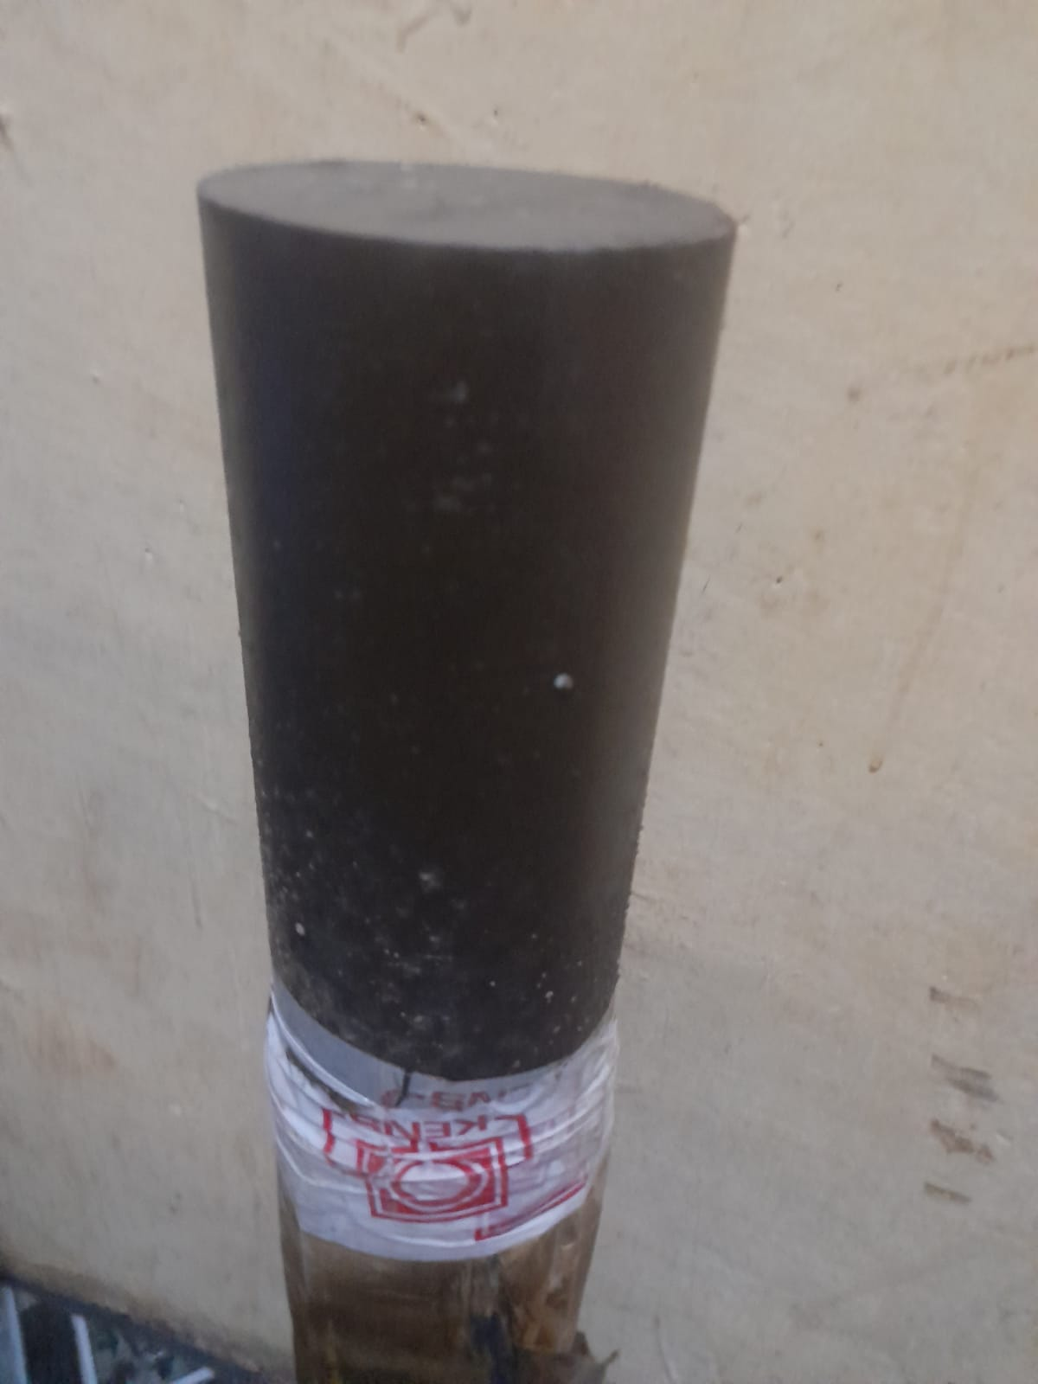
MATERIALS PROCUREMENT
MILD STEEL SOLID SHAFT
BORING TOOL
More materials to be procured beginning of next week

Slide 14
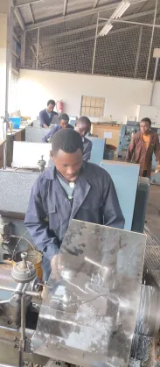
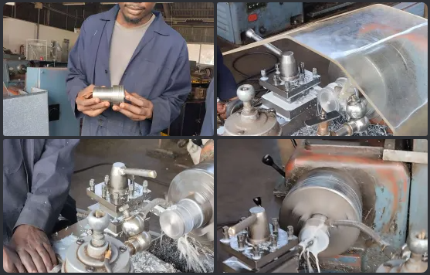
NOZZLES FABRICATION
4 NOZZLES BEGAN FABRICATION

Slide 15
CHALLENGES
 | CHALLENGES
1 | Complications in purchasing and transportation of the SCH40 tube

Slide 16
NEXT WEEKS TASKS
NO. | TASK
1 | Nozzle fabrication progression
2 | Ignition circuit development
3 | Research and redesign of the casting mould progression
4. | Cooking of grains
5. | Machining of more bulkheads
6 | Test stand repair
7 | Static test integrating with the airframe

Slide 17
THANK YOU

